Slide 1

FIND DEFAULT
Prediction of Credit Card Fraud
using Machine Learning

Slide 2
Problem Statement
Credit card fraud is the unauthorized use of someone else's credit card or credit card information to make purchases or withdraw cash.
It is important that credit card companies are able to recognize fraudulent credit card transactions so that customers are not charged for items that they did not purchase.
The dataset contains transactions made by credit cards in September 2013 by European cardholders.
We have to build a classification model to predict whether a transaction is fraudulent or not

Slide 3
This dataset presents transactions that occurred in two days, where we have 492 frauds out of 284,807 transactions.
The Key attributes of the dataset are :
Time: The elapsed time between the first transaction in the dataset and each subsequent transaction, measured in seconds
V1 to V28: These are 28 anonymized features. They are numerical variables that capture various properties of the transactions but have been transformed to protect the confidentiality of the data.
Amount: The monetary value of the transaction. This can be useful for identifying patterns associated with fraudulent transactions.
Class: The target variable, indicating whether a transaction is fraudulent (1) or not (0).

Slide 4
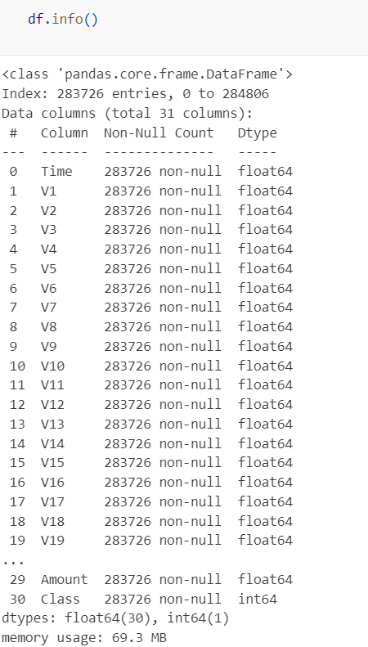
Exploratory Data Analysis
A quick look at the dataset reveals :
There are a total of 283726 entries with the are mainly of numeric variable with float datatype, except for the target field ‘Clas’ which is of int datatype.
There no null values in the dataset.
There are a few duplicate rows which have been removed from the dataset.

Slide 5
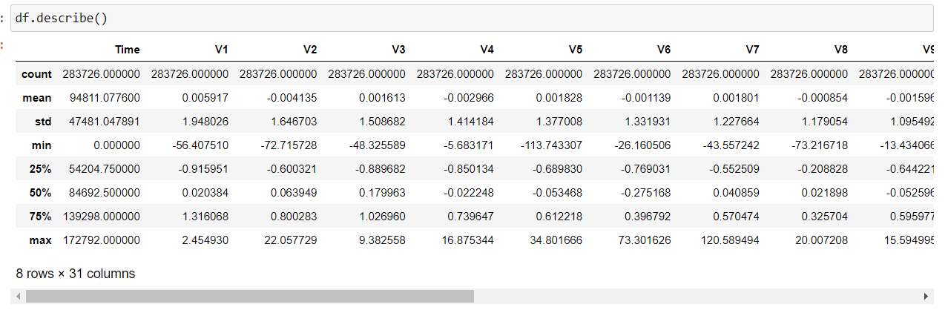
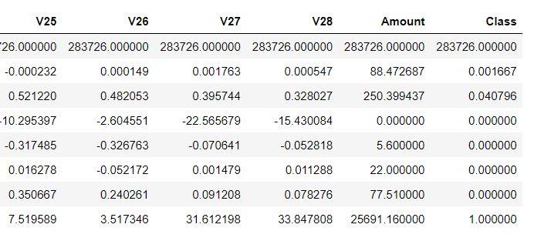
Descriptive Statistics Observations:
For the time feature the mean is at 94811 with min of 0.00 and max of 172792.
For the amount, the mean is 88.472 and the data varies from 0.000 to 25691 which might be due to some outliers.
The rest of v1 to v28 all have mean around the same range and similar std deviations.

Slide 6
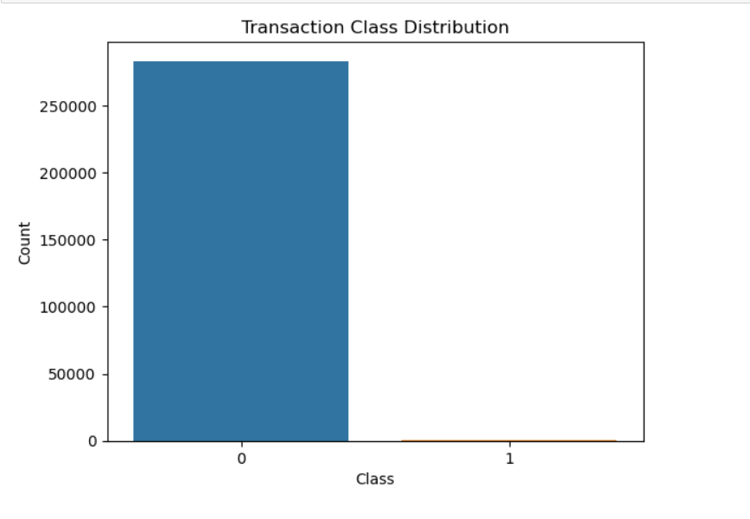
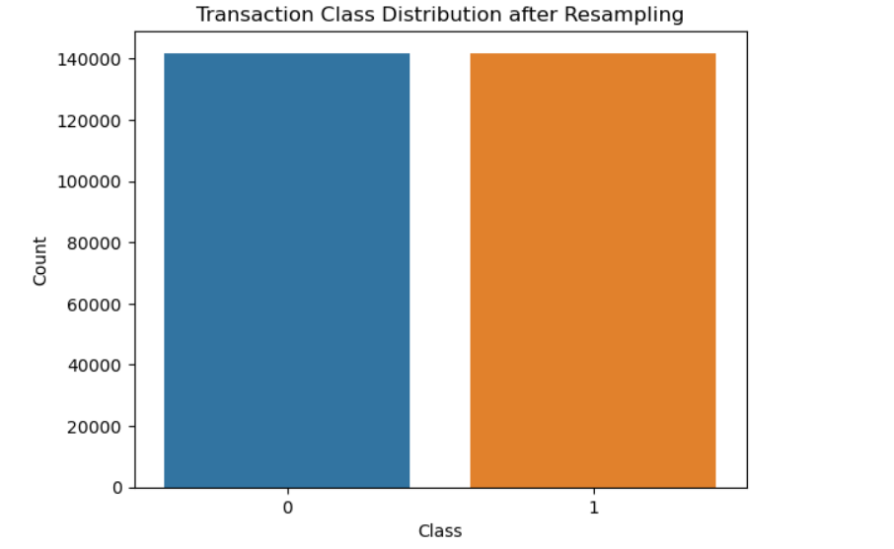
The target variable Class has a high data imbalance as seen by the barchart here.
It has only 492 frauds out of 284,807 transactions, which might lead the model to lean more towards the majority class during prediction.
We can handle this imbalance by a combination of oversampling and undersampling using SMOTE and Undersampler respectively.
After resampling the data is equally distributed with both fraud and non fraud transactions.

Slide 7
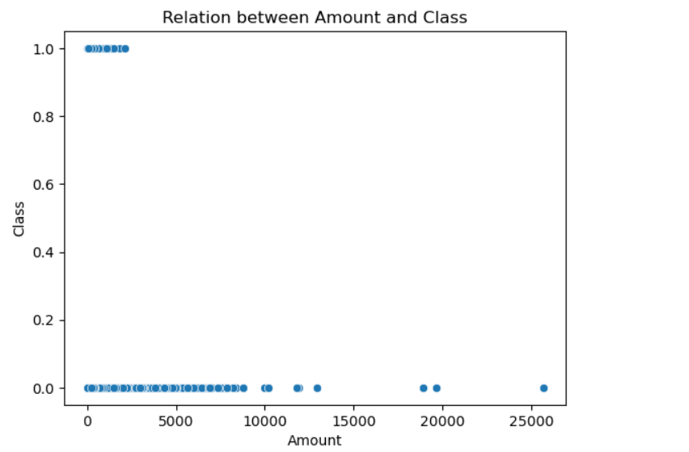
Relationship between transaction Amount and Class
Based on the scatter plot of Amount and Class variables we can observe that for fraud transactions the transactions amounts are on the lower side compared to the non fraud transactions which are higher amounts.
Fraudulent transactions might tend to be smaller amounts, suggesting that fraudsters might try to avoid detection by making smaller transactions.
This indicates that transaction amount seems to be a distinguishing feature between fraudulent and non-fraudulent transactions

Slide 8
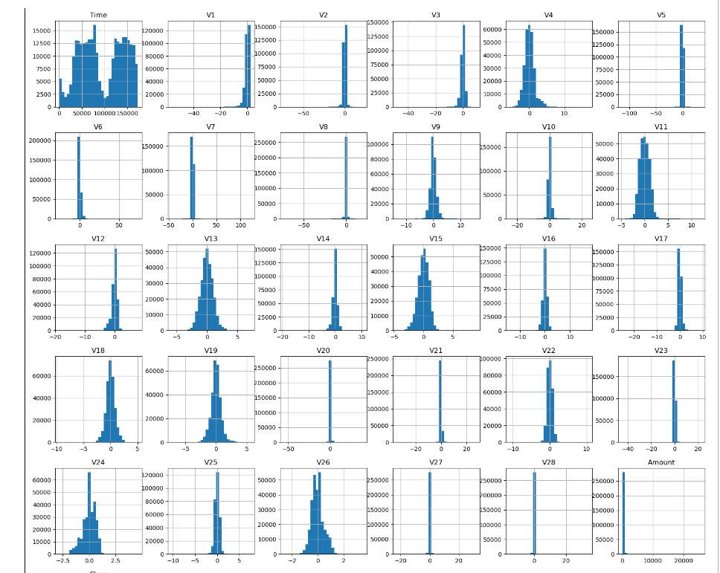
Histogram of all the features
The features of v1 to v28 are all mostly normally distributed around 0.
The Amount has outliers and can be handled accordingly.
The time feature has distribution from 0 to around 17000.
Class also has imbalance distribution around 0 as seen before too.

Slide 9
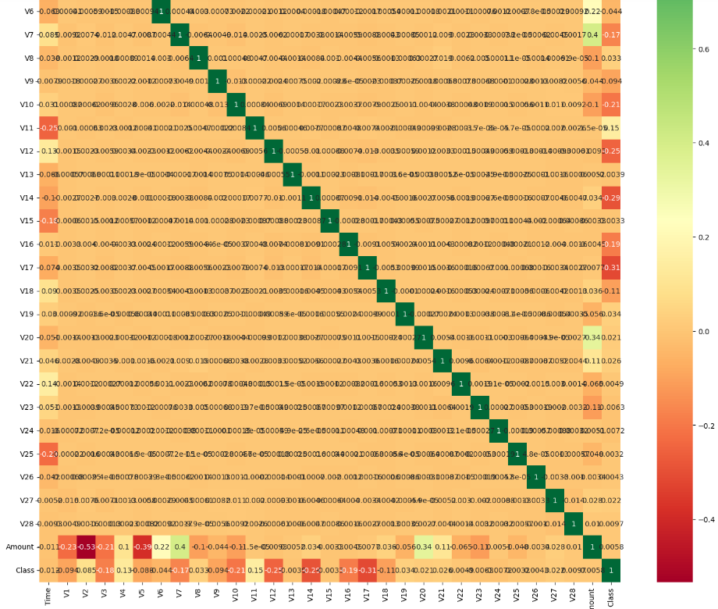
Correlation Matrix
Some of v1 to v28 have a higher correlation to the class variable than others.
Some of them also have negative correlation with the target features.

Slide 10
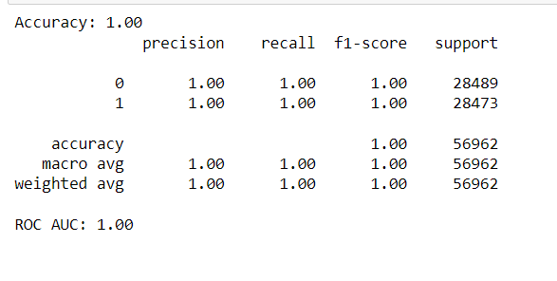
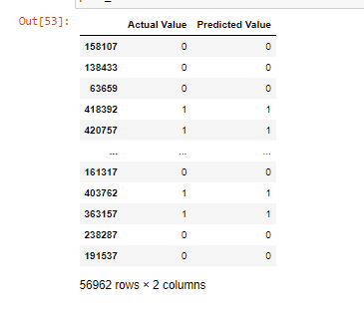
Model Training
Performed the model training on three models
Random Forest
XGBoost Classifiers
K Nearest Neighbors Classifier
Out of the three Random forest had the best accuracy score.
Performed hyper parameter tuning with GridSearchCv .
This tuning process yielded exceptional results,with both the accuracy score and the ROC AUC score reaching 1.00.
Insights:

Slide 11
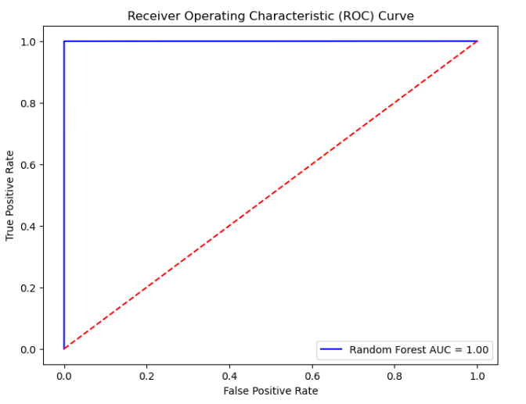
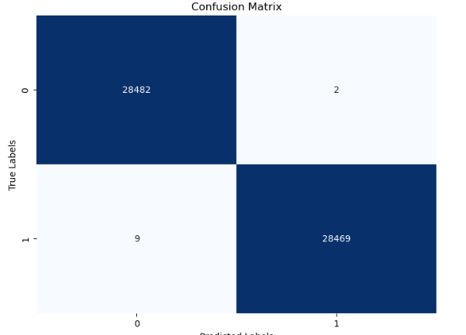
Visualisations on the results best model

